Slide 1

The Only Clean Code /Agile Engineering Practices Conference of India
Bangalore, 19th & 20th of August 2016
www.xpconference.in

Slide 2
About XP Conference India 2016
India’s only CLEAN CODE / XP Engineering Practices conference
Modelled around the popular XP Conference taking place for more than a decade in Europe.
A community event hosted by SolutionsIQ
The conference will see the leaders, and experts of Agile Technical Practices come together to share their learning through demos and workshops
Targeted audience size of over 150 from across industries
www.xpconference.in

Slide 3
Objective: What are we trying to achieve?
“Our primary objective is to promote awareness and importance of Clean Code and XP engineering practices that enables Business Agility, Continuous Delivery and DevOPS.
XP Conference will bring the energy of technology enthusiasts across the country who share one passion - Write Clean Code that is easy to Maintain and Understand.”
www.xpconference.in

Slide 4



Who’s the Conference for?
Developers, Testers, Code architects, QAs,
Tech Team leads, CTOs…
XP Conference is expressly designed for the development community. Anyone who codes and works with teams that code should attend.
PEOPLE looking FOR
Collaboration between Development and other teams
Best Practices for Software Development
Technical Proficiencies
www.xpconference.in

Slide 5
TAKEAWAY from 2 Days
Get Real experience through workshops and technical demos
Debate and Discuss on topics like DevOps, Continuous Delivery, XP, BDD, TDD, Code Design & more
Practical knowledge through key board driven talks
Learn about some of the latest themes and topics around Agile Development
Meet and Network with real practitioners and experts & community members
www.xpconference.in

Slide 6
Workshops @ the Conference
Refactoring For Concurrency (Java) - Tim Myer, SolutionsIQ
Refactoring For Software Design Smells (Java) – Ganesh Samarthyam, Codeops Technologies
Writing Secure Code – Priti Biyani and Shirish Padalkar, Thoughtworks
Componetize- Respond to what your code and business are saying (TDD/Java) – By Lance Kind
The Craft of Business Friendly Design - A workshop on Domain Driven Design - Ranjith Tharayil
Behaviour Driven Development – Banu Prakash , Society Generale
Building a Serverless Application with Node.js – Vinay Krishna –SolutionsIQ
Pitfalls of Continuous Deployment – Siddharta Govindaraj, Silver Stripes Software
Introduction to Docker – Aditya Patawari
Caution: You need to write real code in these workshops. There will be a local repository with CI and Github set up. Pl install software by looking at the workshop page on XPConference.in

Slide 7
Talks & Demos @ The Conference
Feature Toggle - Why , What and How – Kalpna Prakash , Pitney Bowes
Do DevOps Like Lance Armstrong – Yahya Poonawala , ShopSocially
Journey With XP- A Case Study in Embedded Domain - Pradeep Kumar NR, Cisco
Building Big Architectures with Docker and Microservices – Ramit Surana, The Remote Lab
Bashing Cultural Monsters in Continuous Integration – Vivek Ganesan, Gainsight
Pairwise testing in the Agile World – Arun Srinivasan and P Krishnamurthy, GE Healthcare
Perspective of Continuous Integration at Scale – Hrishikesh Karekar and Vinaya Murlidharan, Amdocs
Zero Bug Manager – Dave Wylie, Engineering Director, SolutionsIQ
Introducing XP Practices in Teams, Vision and Its Challenges - Sunil Gupta, Sr. Eng. Manager, Cisco Systems
Gamifying Open Source – Gautam Rege, Josh Software
www.xpconference.in

Slide 8



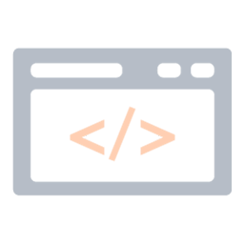

9 Engaging Workshops
10+ Exciting Talks and Demos
DevJam and Coding Sessions
All for one Price!
INR 12000/USD 180
Register Here

Slide 9
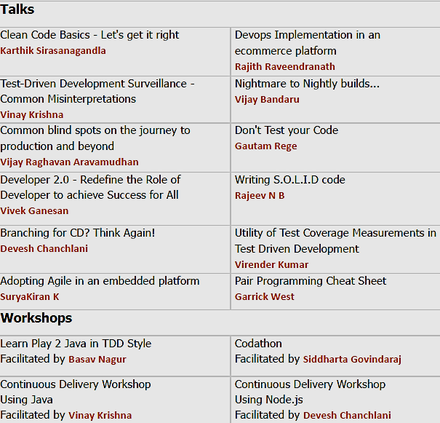
XP Conference India 2015
2015 was the first year of XP Conference India.
150+ attendees
Received active participation from 35+ companies including Intel, Mckinsey, Cognizant, Honeywell, TCS, Society Generele, Cisco, Intuit, Hitachi, Mindtree, ABB, TCS, Valtech, Brady Corp, Infosys and many more.

Slide 10

Hosted By
SolutionsIQ is the a global leader of Agile Transformation Services assisting businesses in their journey to Business Agility
SolutionsIQ has a global reach to help diversified Industries to successfully adopt methodologies like Agile engineering practices (XP), Scrum, Lean, and Kanban.
SolutionsIQ Agile Engineer Lab helps customer deliver complex software with Zero Bug Guarentee for the last 18 years
Learn more at SolutionsIQ.com
www.xpconference.in

Slide 11
India Focused Conference with an International Quality
See you there!
Learn from Talks and Workshops and Share at DevJams
Once in a year opportunity to learn from many Coding Experts under one roof
Experiential sessions over one-to-many talks
Attractively priced
www.xpconference.in

Slide 12



Contact Us Today!
E-mail: contact@xpconference.in
Call: +91 80 2344 9999
Follow Us
Twitter
LinkedIn
Facebook
www.xpconference.in

